Slide 1




Management Science
Della Herli Rahman (16/394080/PA/17171)
Vincent Michael Sutanto (16/398531/PA/17492)

Slide 2

Transportation Management

Slide 3
Problem
Method
Implementation
Result

Slide 4
Problem
01
Orders
Origin
Destination
Qty
Weight
Minimum Cost
100

Slide 5
Problem
Method
Implementation
Result

Slide 6
Method
N Shortest Path Tree

Slide 7
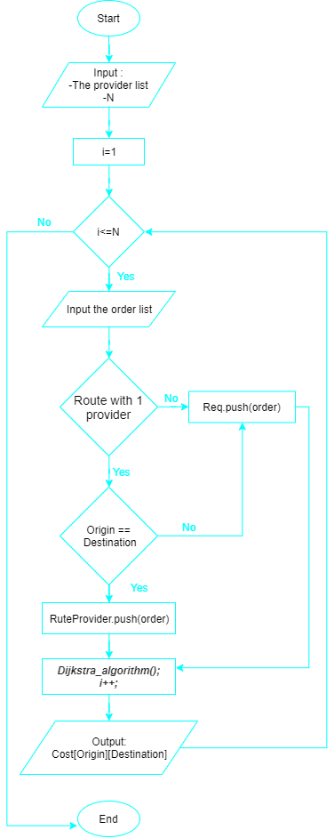
Method

Slide 8
Method

Slide 9
Method
Assign
Data[15][15] , 7 providers + 8 cities
Data[i][j]= cost city i using provider j
Input
1
Provider
Order
5
Output /order
3
cost * qty * weight
4
2
Process /order
Preprocessing
Dijkstra's algorithm
Finding minimum cost by route
Update capacity and request
Filter Order
Sorting Orders

Slide 10
Problem
Method
Implementation
Result

Slide 11
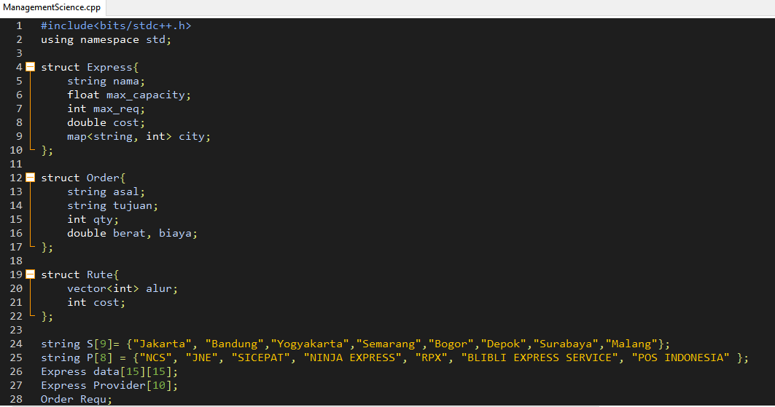
Implementation : C++

Slide 12
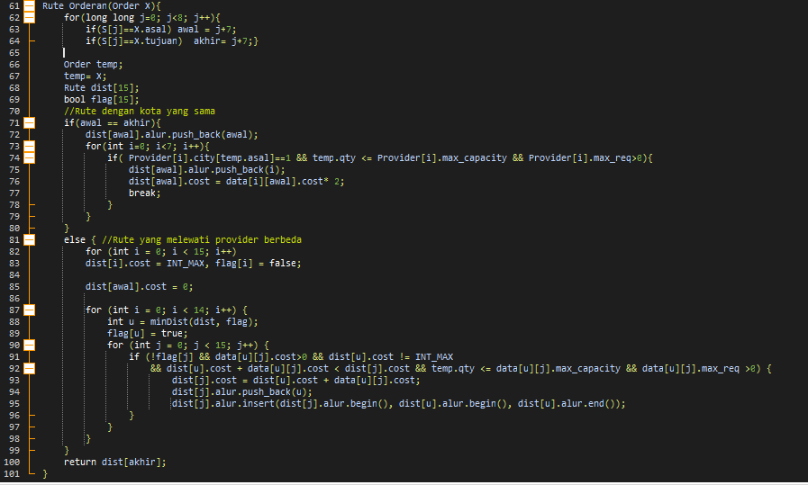
Implementation : https://github.com/dellahera/Transportation-Management/

Slide 13
Problem
Method
Implementation
Result

Slide 14
Result
01
Input
Total Cost:
Rp. 469.922.942, 00
100

Slide 15
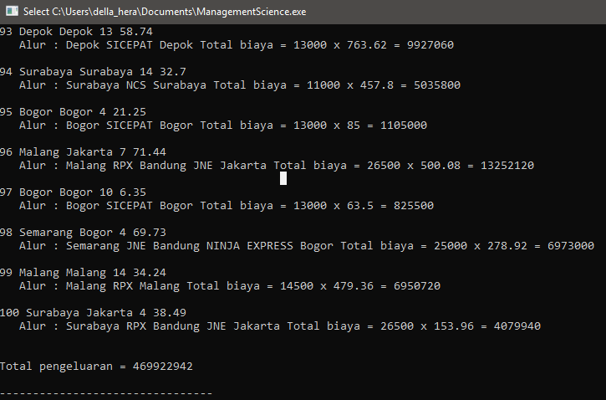
Result

Slide 16
Thank you

